Slide 1
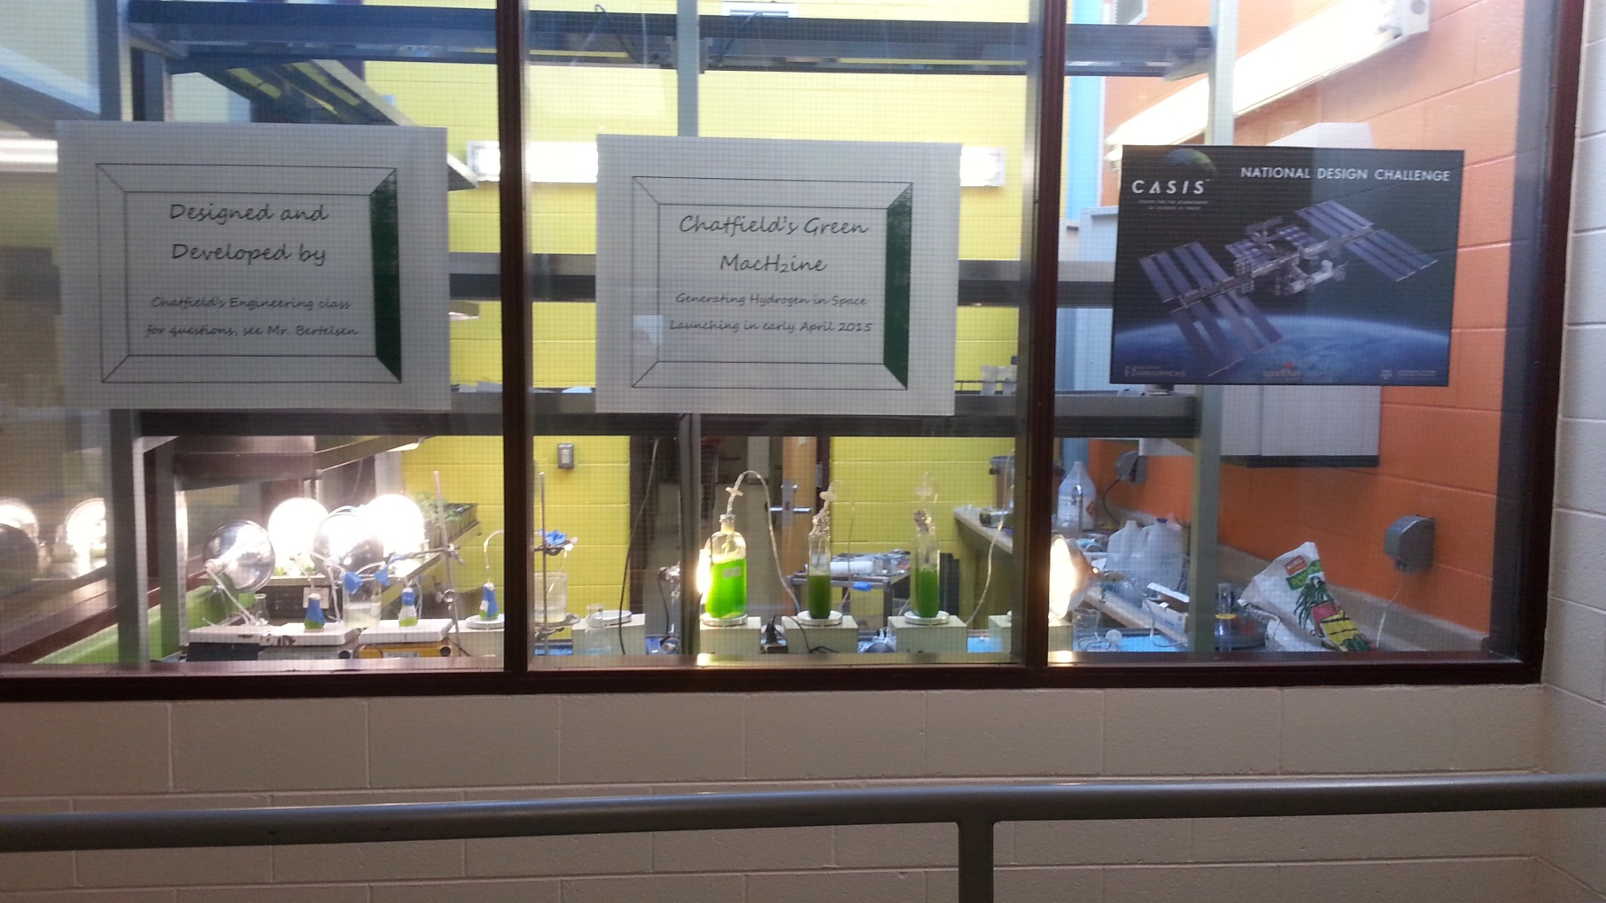
CASIS NDC Denver Pilot 2014 Chatfield’s Green Machine
Chatfield Senior High School’s Intro to Engineering Class

Slide 2
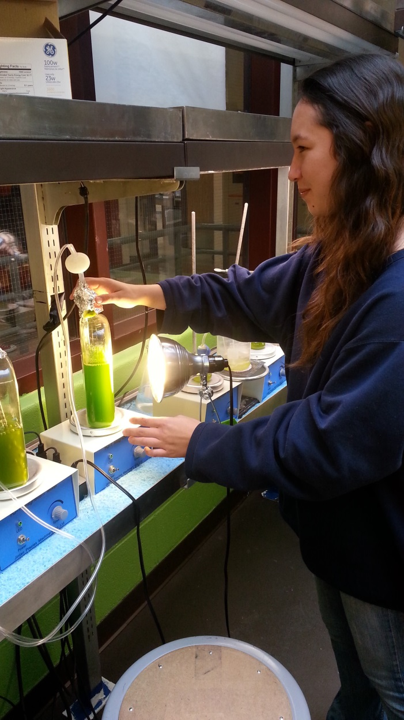
Chlamydomonas reinhardtii: Hydrogen Production in Space

Slide 3
Research
“Continuous Hydrogen Photoproduction by Chlamydomonas reinhardtii”, National Renewable Energy Laboratory
Scientists at NREL demonstrated the ability to generate hydrogen when algae experience stress due to sulfur limitations in growth media

Slide 4
Key Elements:
Chlamydomonas grown in sulfur rich, Tris-acetate-phosphate (TAP)
Cells are then transferred to sulfur limited media: Tris-Acetate-Phosphate minus Sulfur (TAP-S)
Hydrogen production by Chlamydomonas caused by the hydrogenase enzyme evolving hydrogen in anaerobic conditions
Anaerobic environment established by allowing no headspace in bioreactor

Slide 5
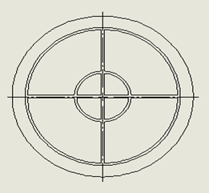
Our Design
Four chambered bioreactor with varying concentrations of sulfur to delay onset of hydrogen production
Each chamber connected to central gas collection chamber to allow hydrogen to diffuse out of solution
Hydrogen detection tape used in central location to indicate when hydrogen has been produced.

Slide 6
Current Experiments:
Magnesium Sulfate: testing varying concentrations of magnesium sulfate in TAP-S to delay hydrogen production predictably
Pellet: testing the survivability of algae in “pellet form” (algae centrifuged from TAP and left for certain time)
Effects of cold temperatures on the ability of Chlamydomonas to produce hydrogen
Effects of headspace on hydrogen production

Slide 7
Results
Inconclusive at this time
We have only generated hydrogen on once occasion
Modifications have yet to produce hydrogen
Algae in pellet form has not produced hydrogen

Slide 8
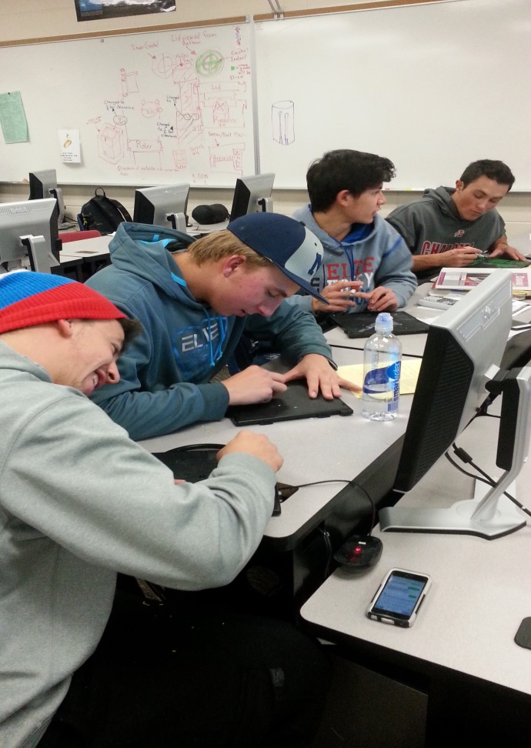
Chlamydomonas Hardware

Slide 9
Materials
Gas Permeable Membrane
Bio Reactor/Box/Rollers-ABS Plastic
Clear Caulking
Motor
Hydrogen Tape
Clear Lid-Polycarbonate
Fasteners

Slide 10
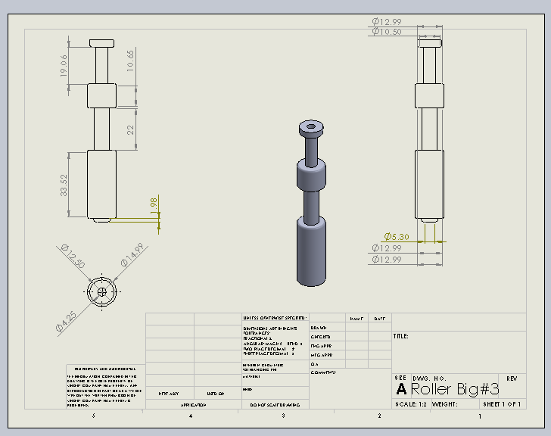
Support Rollers

Slide 11
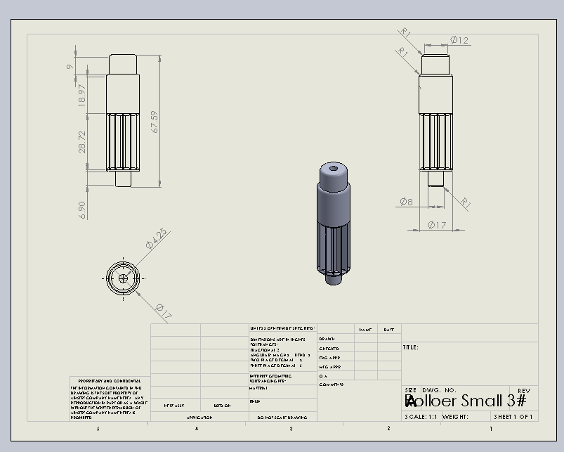
Motor Roller

Slide 12
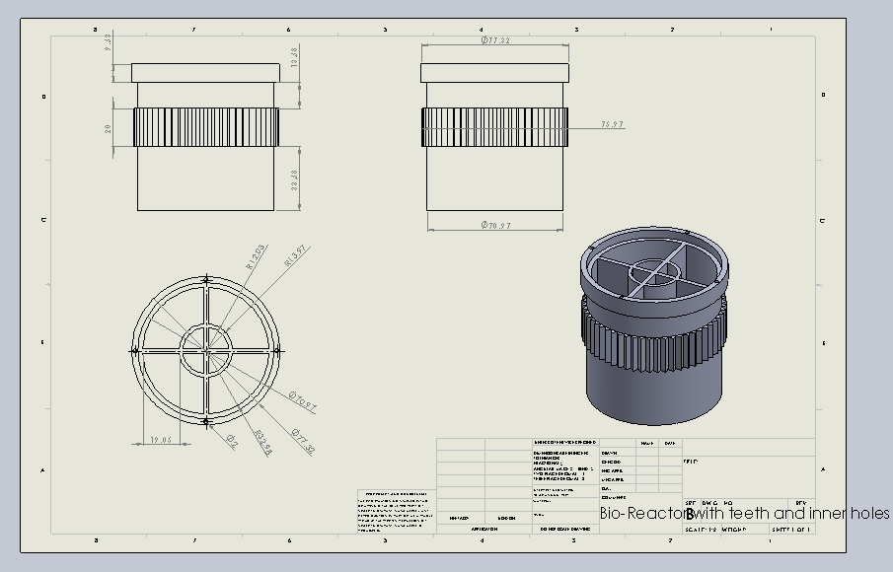
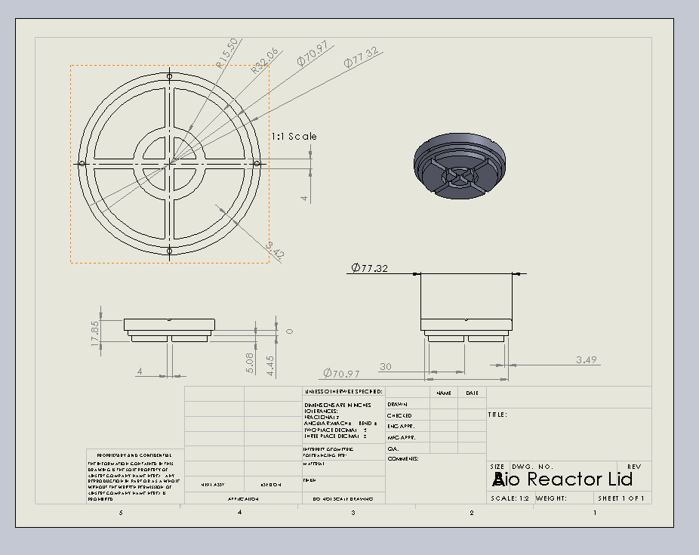
Design-Bio Reactor and Lid

Slide 13
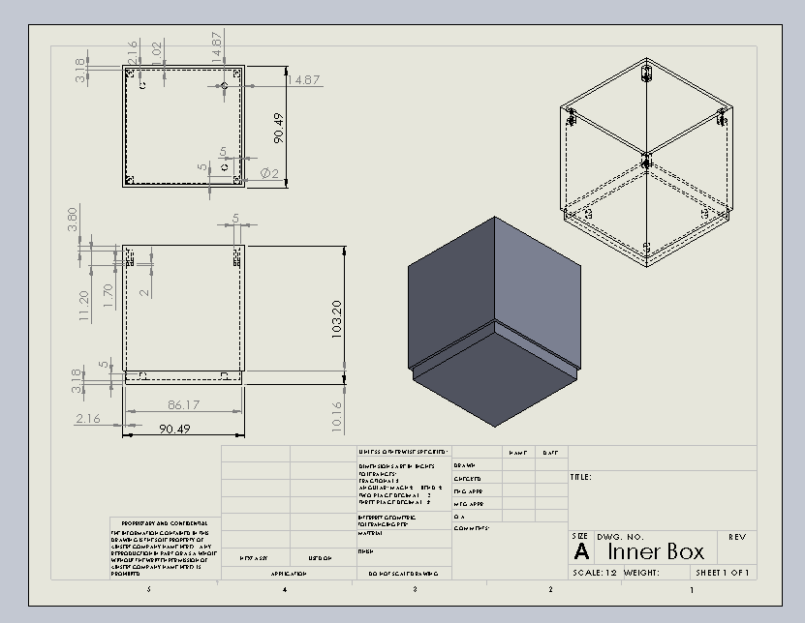
Inner Box

Slide 14
Final Assembly

Slide 15
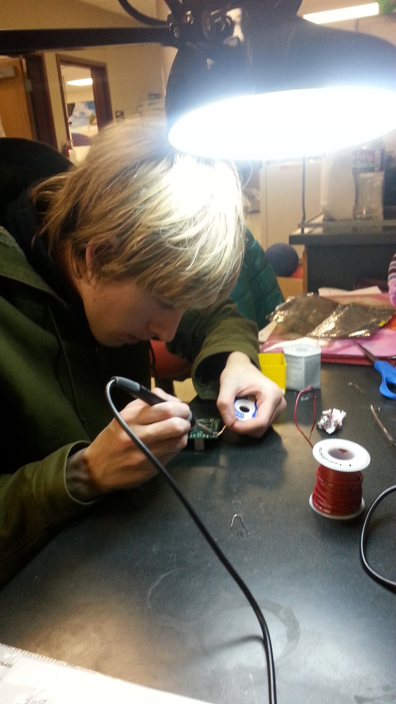
Chlamydomonas Software Group

Slide 16
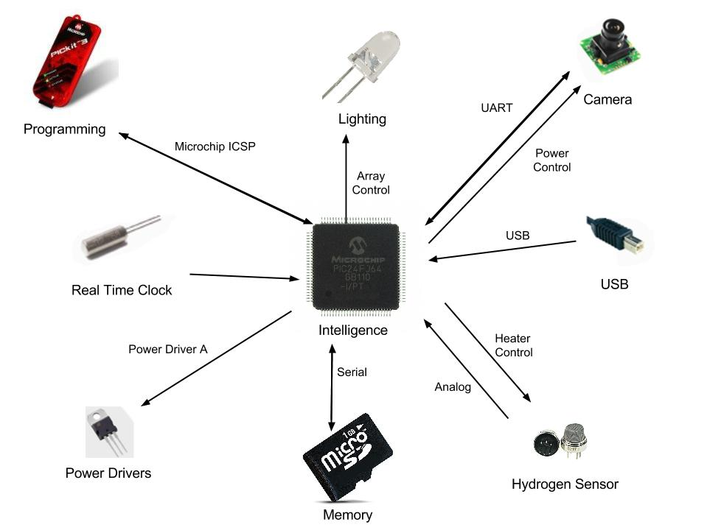
Chlamydomonas: Conceptional Block Diagram

Slide 17
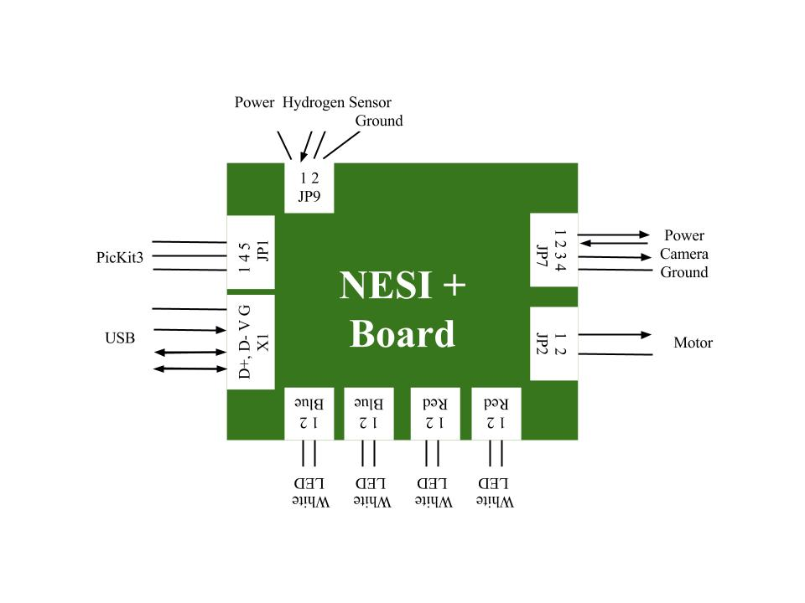
Functional Block Diagram

Slide 18
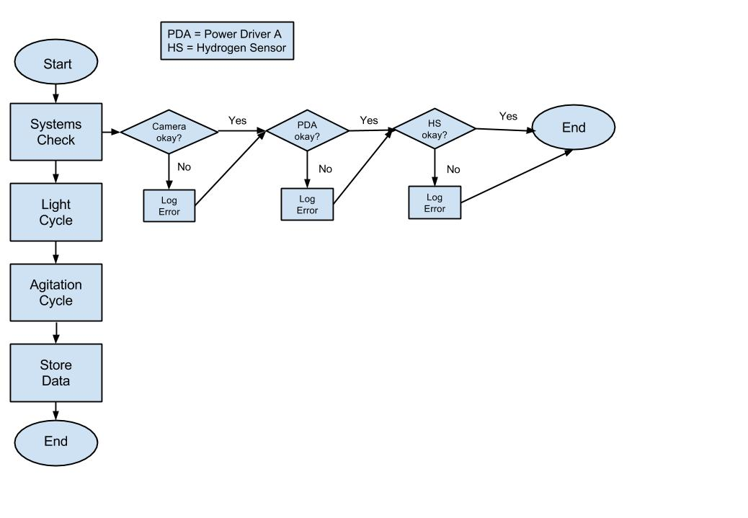
Story Board: System Check

Slide 19
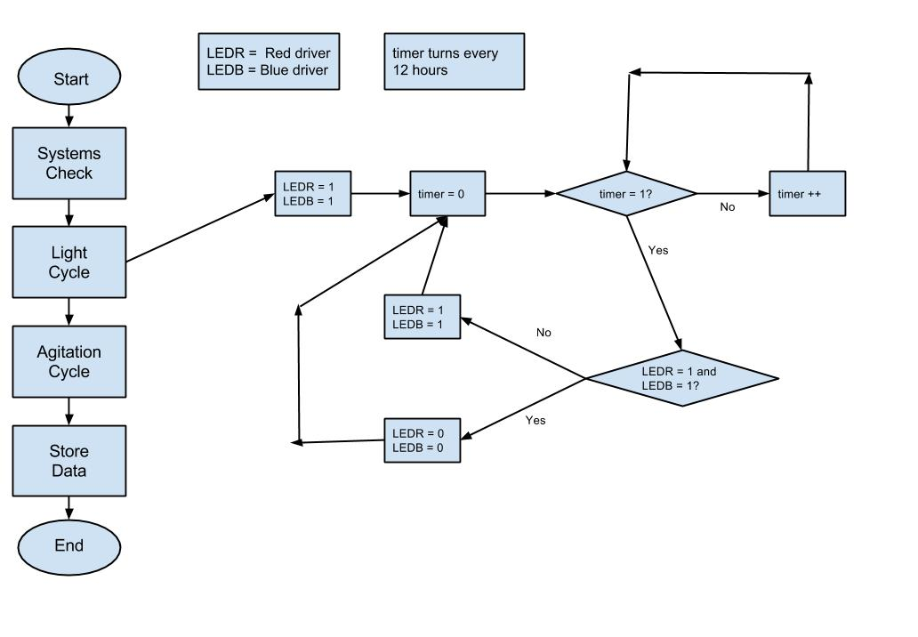
Story Board: Light Cycle

Slide 20
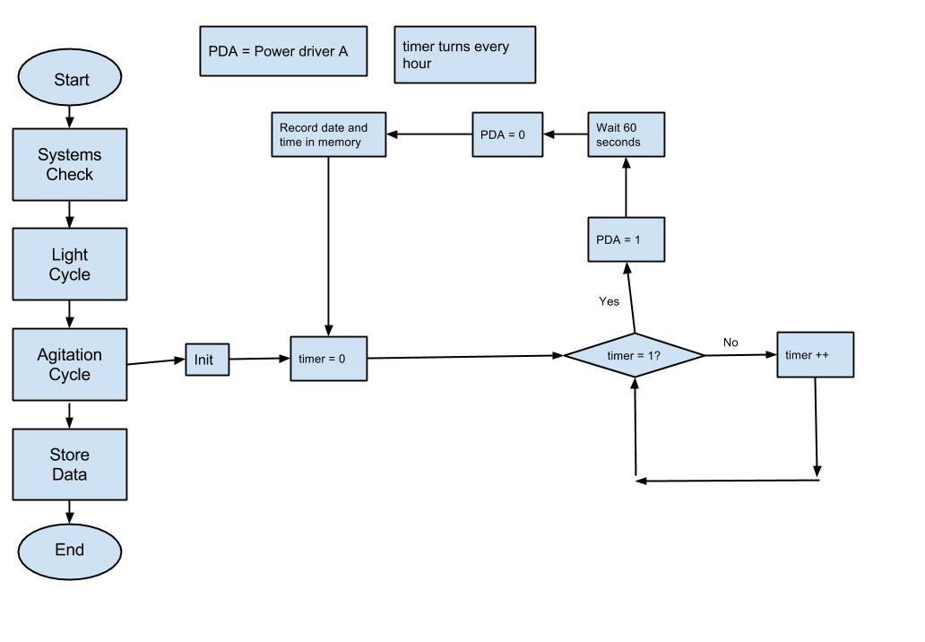
Story Board: Agitation Cycle

Slide 21
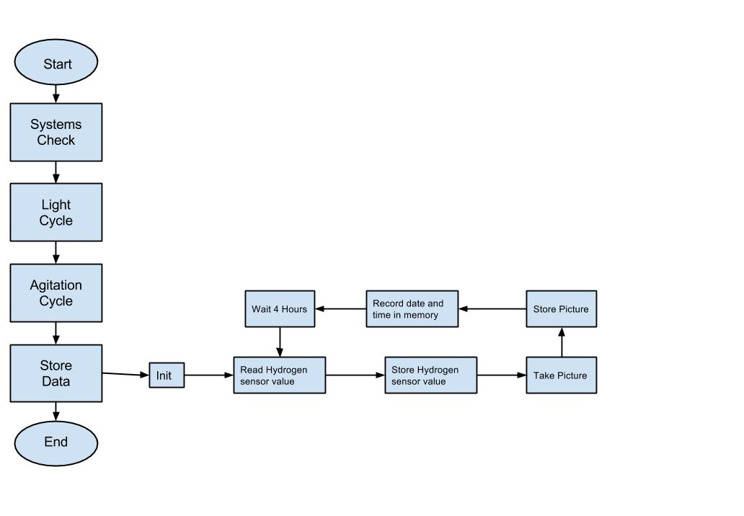
Story Board: Store Values

Slide 22
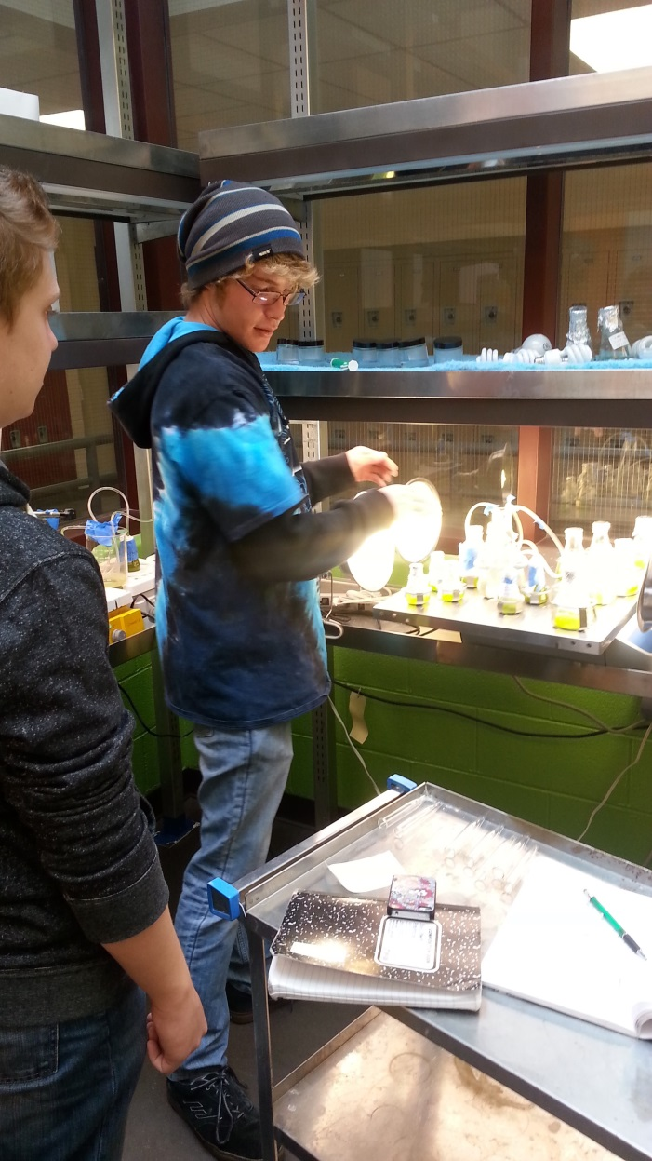
Chlorella vulgaris: Lipid Production in Space

Slide 23
Research
Various groups have shown that Chlorella vulgaris responds to nitrate stress by storing lipids within the cell
By limiting the concentration of nitrate within the bioreator, the algae begin lipid production
These fats can be harvested an processed into biofuels

Slide 24
Our Design
4 chambered bioreator with varying density of cells to study effect of cell density on lipid production
Lights on NESI board shine through each bioreactor to photosensors at the bottom
As lipids are produced, more light will be absorbed by the algae
Added absorbance registered by photosensors
Bioreactor designed to keep solution contained with a head space ratio of 5:1

Slide 25
Our Experiments
Testing bioreactors with varying concentrations of nitrate to determine concentration to produce maximum nitrates at the launch + 3 week time frame.
Absorbence tested in spectrometer to determine differences in concentrations of lipids in solution

Slide 26
Results
Inconclusive at this time
Algae does not seem to have stored significant lipid concentrations as determined visually
As lipids accumulate, solution turns a mustard yellow
We have yet to observe this

Slide 27
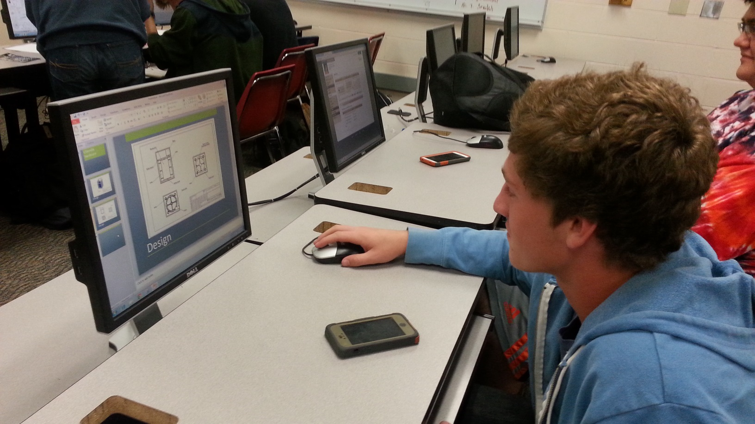
Chlorella Hardware

Slide 28
Design Overview

Slide 29
General Design

Slide 30
Bioreactor Design

Slide 31
End Support Design

Slide 32
Bioreactor Support Design

Slide 33
Interior Box Design

Slide 34
Motor Mount Roller Design

Slide 35
General Roller Design

Slide 36
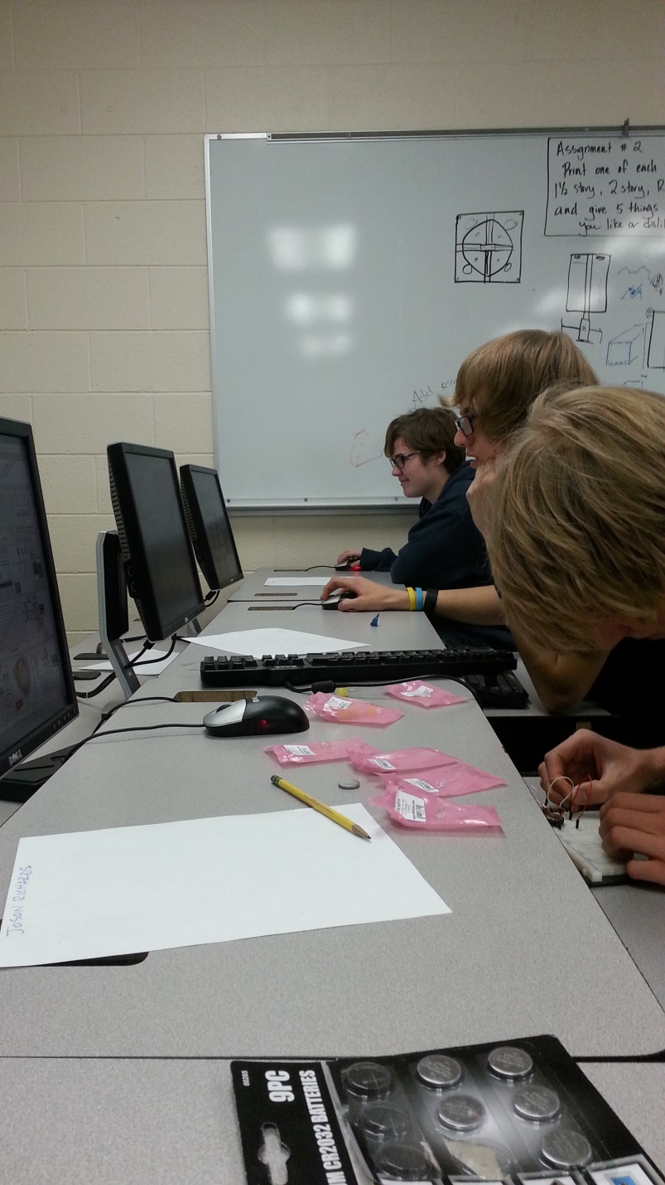
Chlorella Software Group

Slide 37
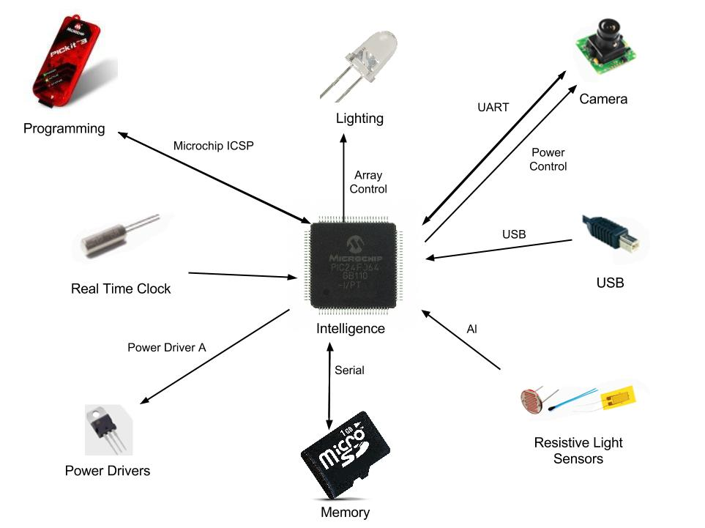
Conceptual Block Diagram

Slide 38
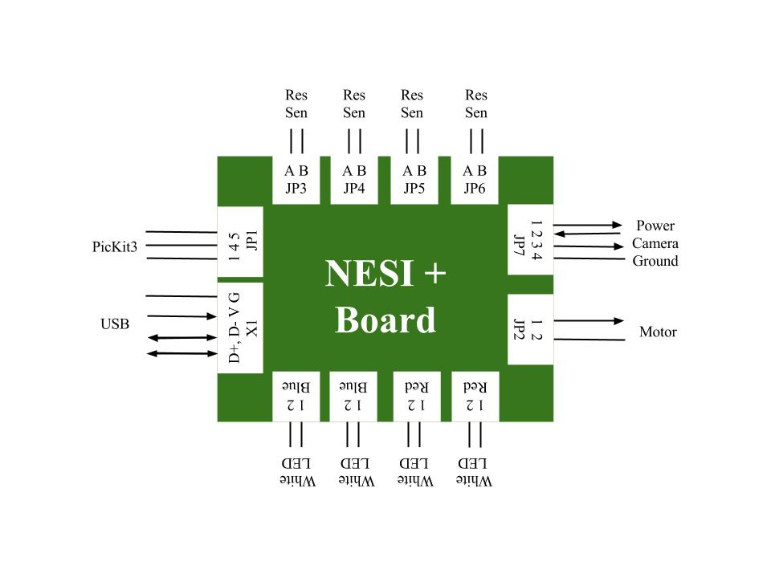
Functional Block Diagram

Slide 39
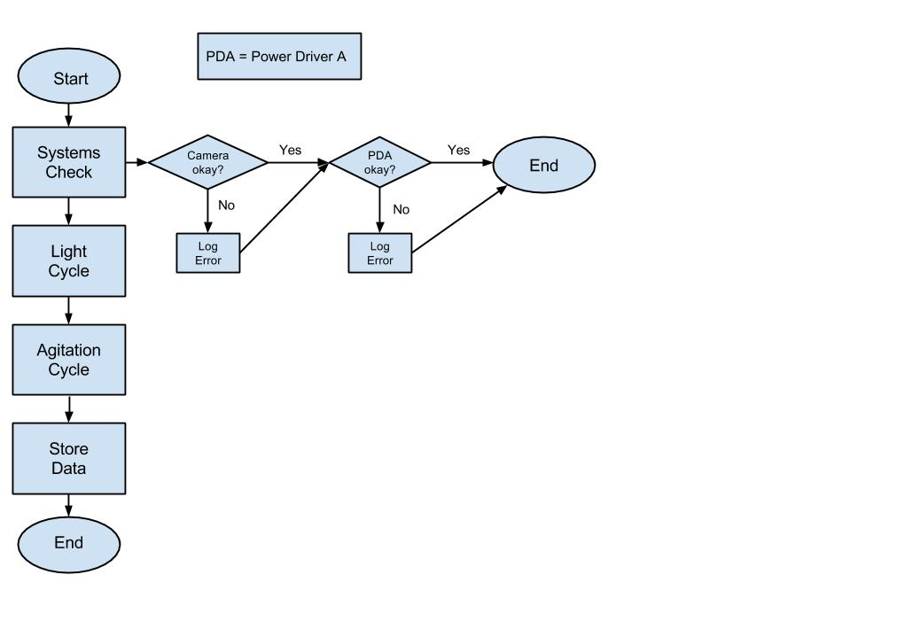
Story Board: System Check

Slide 40
Story Board: Light Cycle

Slide 41
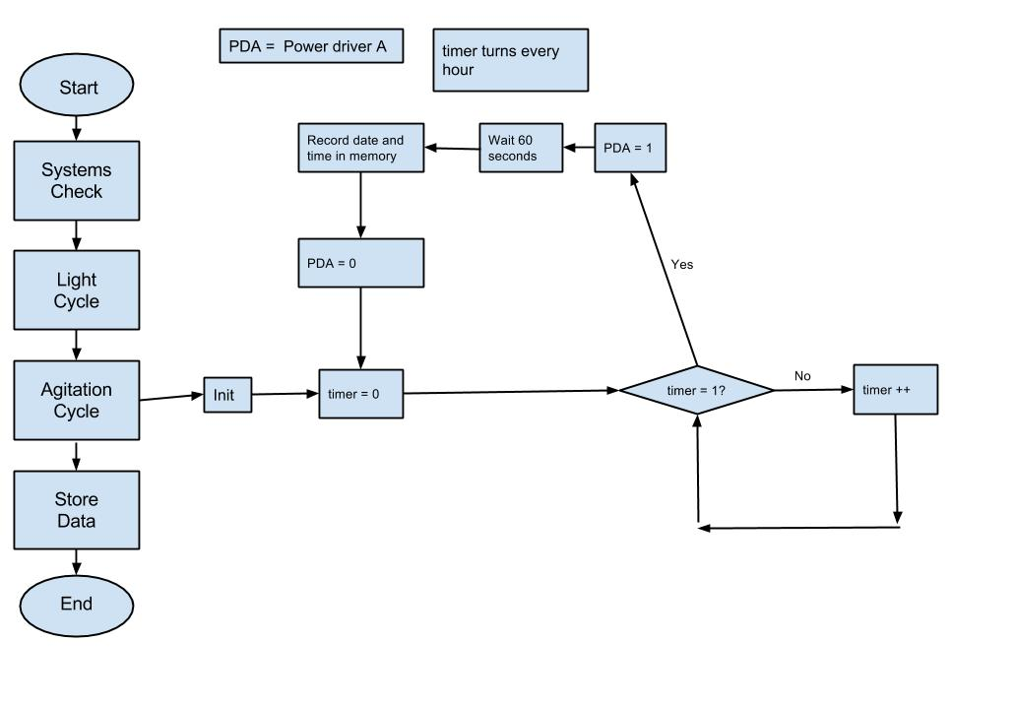
Story Board: Agitation Cycle

Slide 42
Story Board: Store Values

