Slide 1
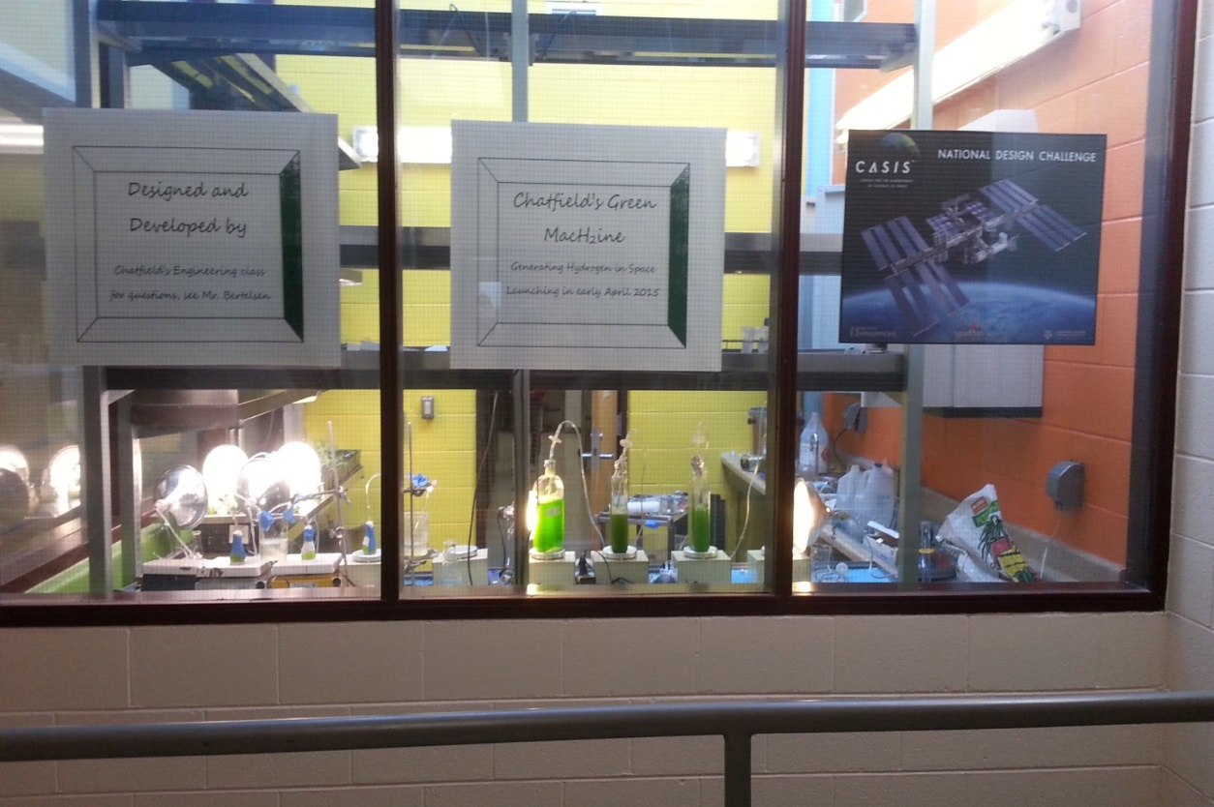
CASIS NDC Denver Pilot 2014 Chatfield’s Green Machine
Chatfield Senior High School’s Intro to Engineering Class
Joel Bertelsen – Lead Educator
Trevor Schrepel – Chlorella Hardware
Tyler Gilchrist – Chlamydomonas Hardware
Cory Baxes – Software
Tim Stroup – Software
Paul Stanfel - Science

Slide 2
Two Experiments for the price of one!
The effect of microgravity on the ability of algae to produce biofuels in space
We are currently working two science pathways
Chlamydomonas reinhardtii
Produces hydrogen when under sulfur stress
Chlorella vulgaris
Cells store lipids when under nitrate stress
The two experimental designs are quite similar with many common elements, allowing us to utilize lessons learned from both experiments to guide our final design.

Slide 3
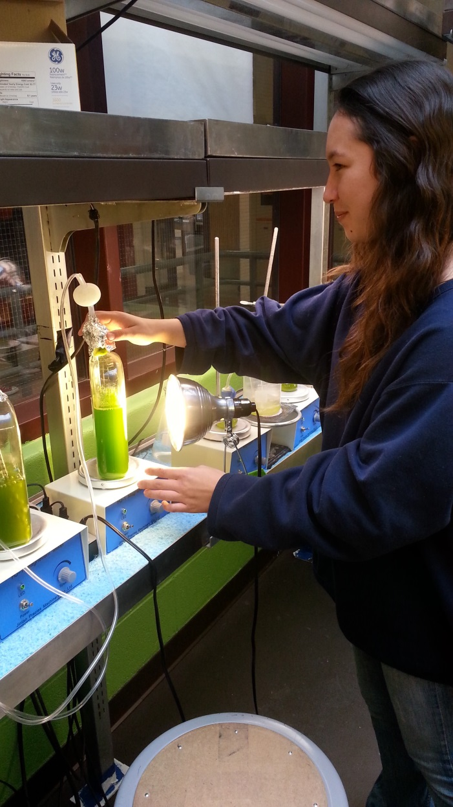
Chlamydomonas reinhardtii: Hydrogen Production Paul Stanfel

Slide 4
Research
“Continuous Hydrogen Photoproduction by Chlamydomonas reinhardtii”, National Renewable Energy Laboratory
Scientists at NREL demonstrated the ability to generate hydrogen when algae experience stress due to sulfur limitations in growth media
We found a few groups working to bring hydrogen producing algae to space but they have yet to fly

Slide 5
Key Elements:
Chlamydomonas grown in sulfur rich, Tris-acetate-phosphate (TAP)
Cells are then transferred to sulfur limited media: Tris-Acetate-Phosphate minus Sulfur (TAP-S)
Hydrogen production by Chlamydomonas caused by the hydrogenase enzyme evolving hydrogen in anaerobic conditions
Anaerobic environment established by allowing no headspace in bioreactor

Slide 6
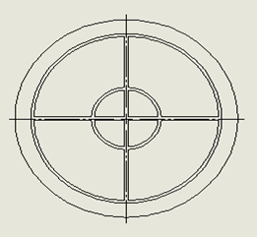
Our Current Design
Four chambered bioreactor with varying concentrations of sulfur to delay onset of hydrogen production
Each chamber connected to central gas collection chamber to allow hydrogen to diffuse out of solution
Hydrogen detection tape used in central location to indicate when hydrogen has been produced.

Slide 7
Current Experiments:
Magnesium Sulfate: testing varying concentrations of magnesium sulfate in TAP-S to delay hydrogen production predictably
Pellet: testing the survivability of algae in “pellet form” (algae centrifuged from TAP and left for certain time)
Effects of cold temperatures on the ability of Chlamydomonas to produce hydrogen
Effects of headspace on hydrogen production

Slide 8
Results
Inconclusive at this time
We have only generated hydrogen on one occasion
Modifications have yet to produce hydrogen
Algae in pellet form has not produced hydrogen

Slide 9
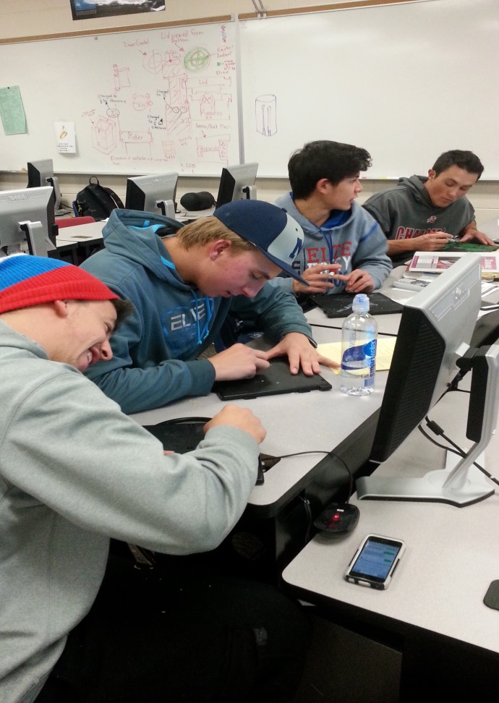
Chlamydomonas Hardware Tyler Gilchrist

Slide 10
Materials
Gas Permeable Membrane
Bio Reactor/Box/Rollers-ABS Plastic
Gasket to seal bioreactor
Motor
Hydrogen Tape
Clear Lid-Polycarbonate
Fasteners

Slide 11
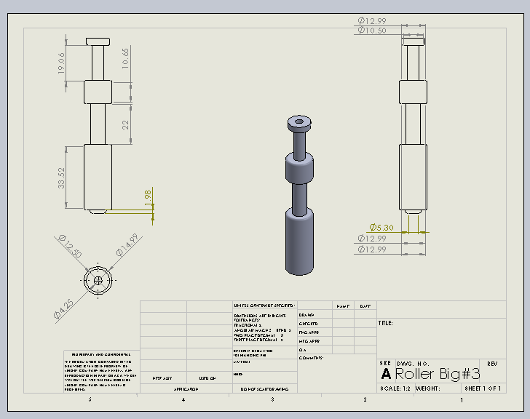
Support Rollers

Slide 12
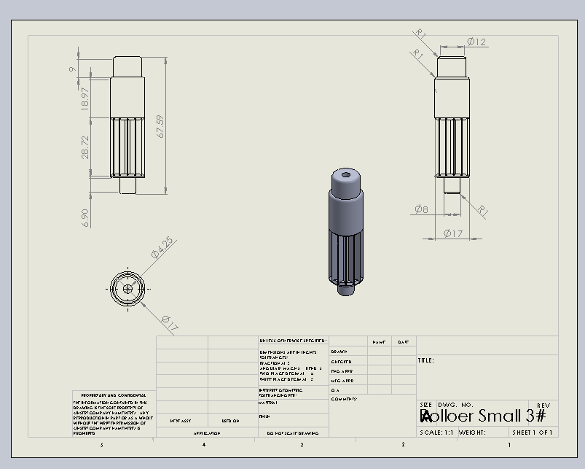
Motor Roller

Slide 13
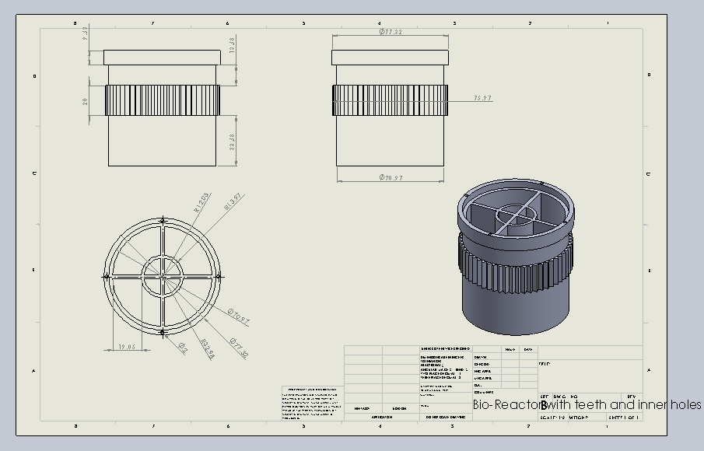
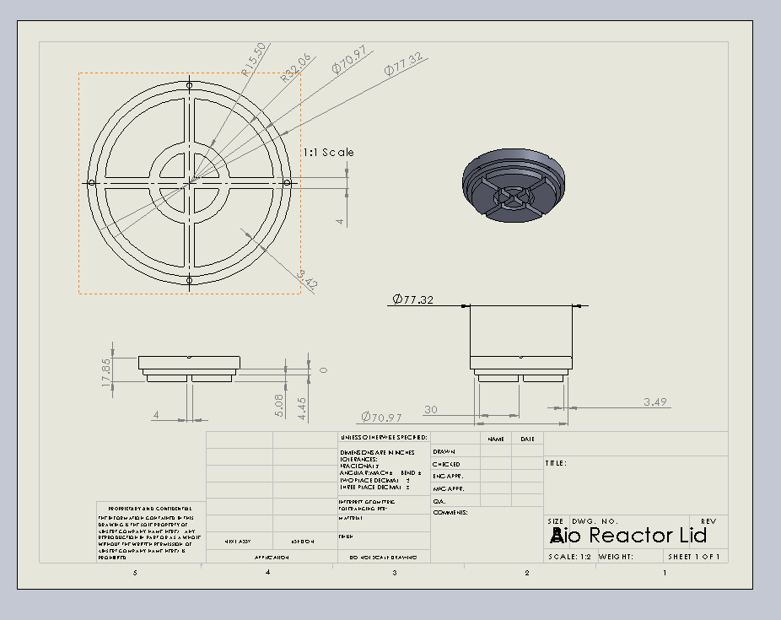
Design-Bio Reactor and Lid

Slide 14
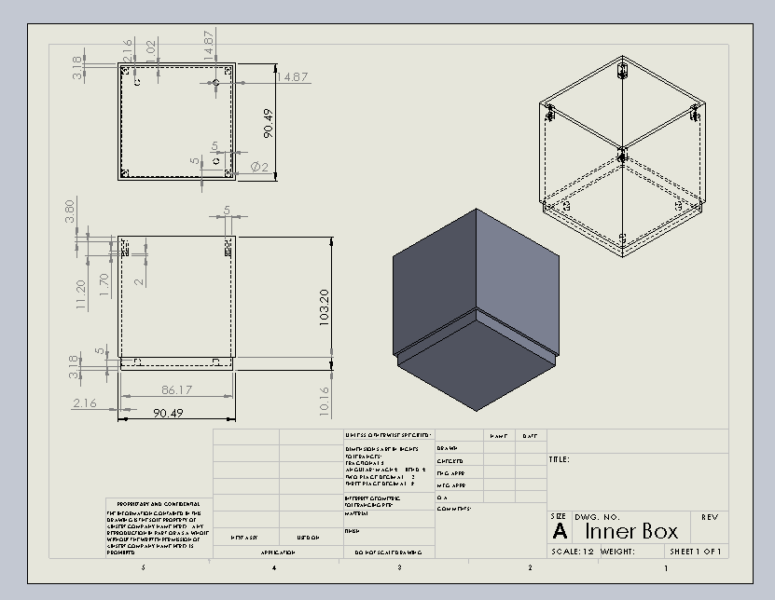
Inner Box

Slide 15
Final Assembly

Slide 16
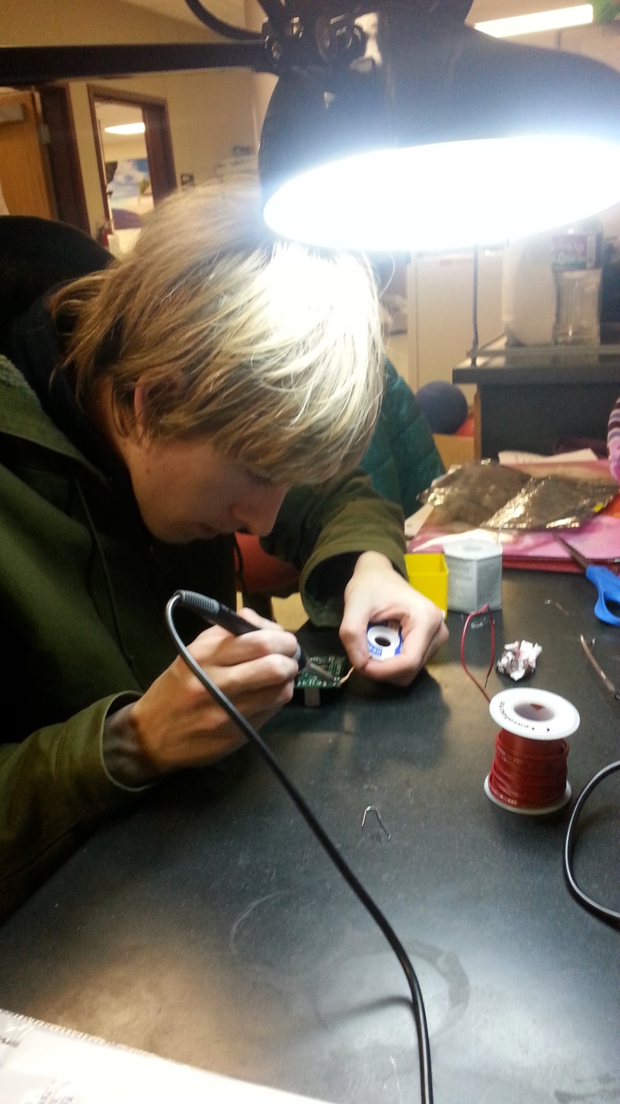
Chlamydomonas Software Group Cory Baxes Tim Stroup

Slide 17
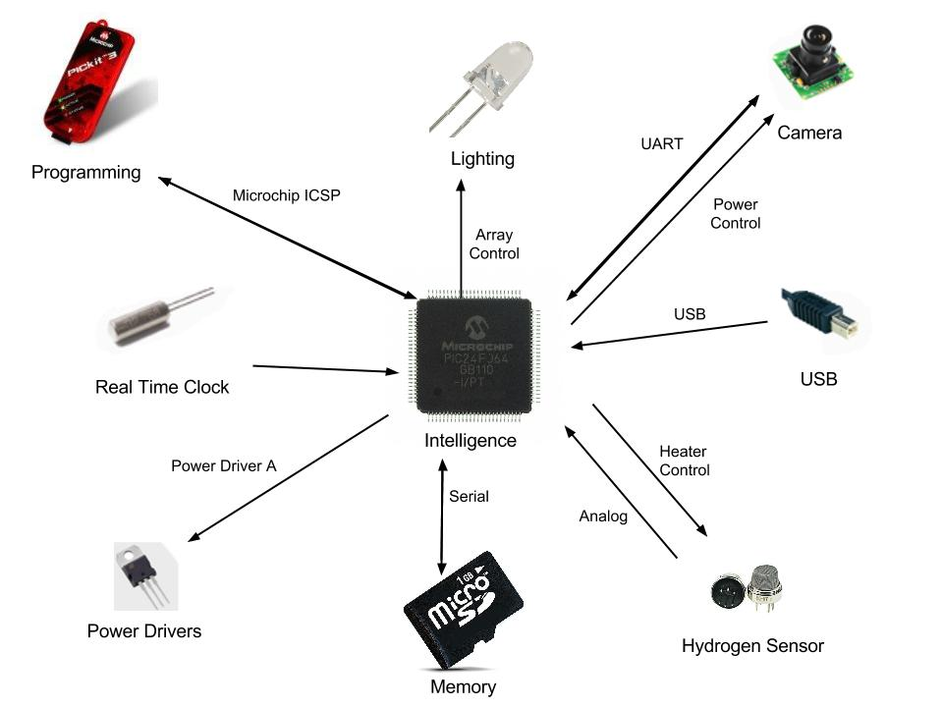
Chlamydomonas: Conceptional Block Diagram

Slide 18
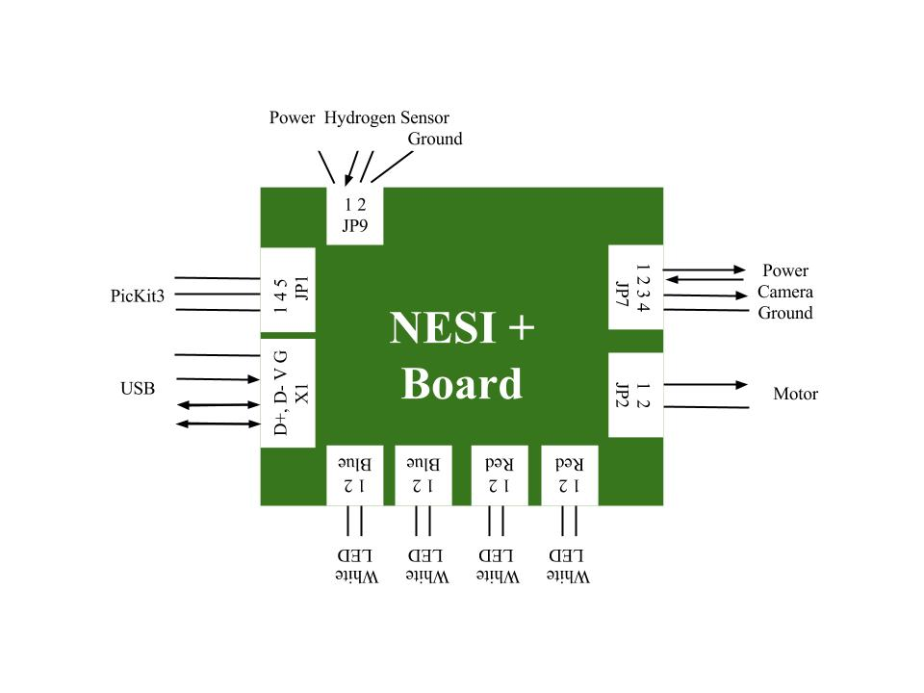
Functional Block Diagram

Slide 19
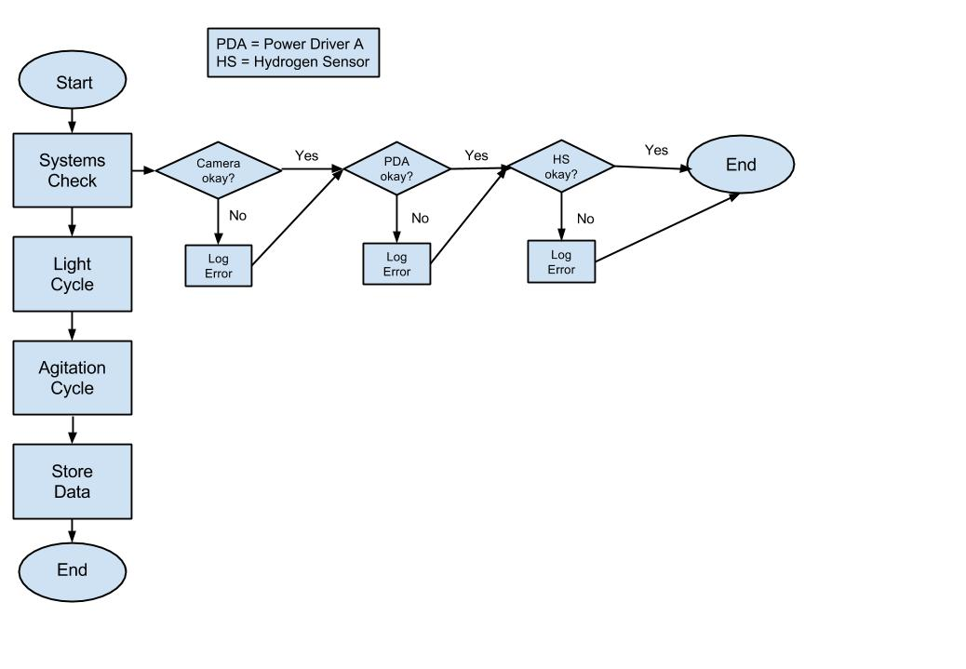
Story Board: System Check

Slide 20
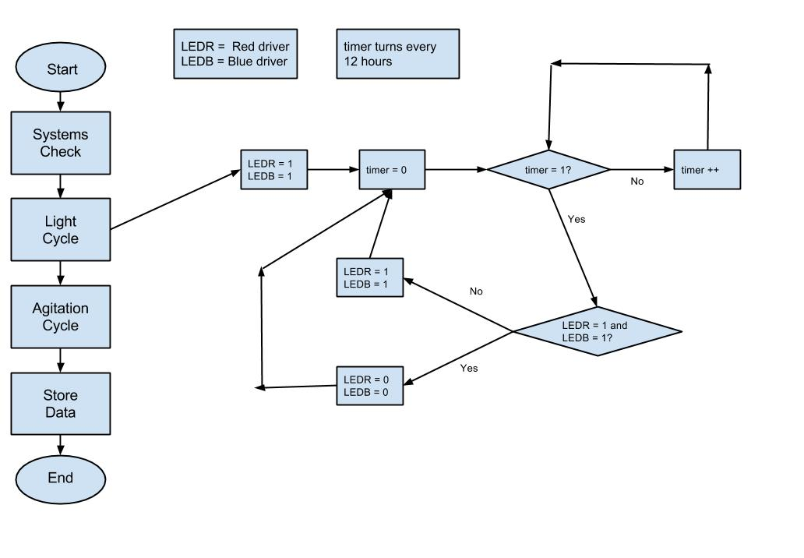
Story Board: Light Cycle

Slide 21
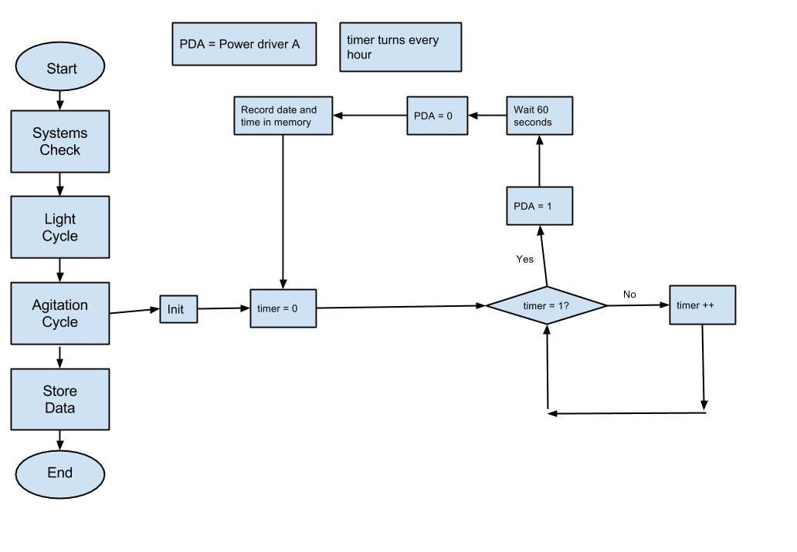
Story Board: Agitation Cycle

Slide 22
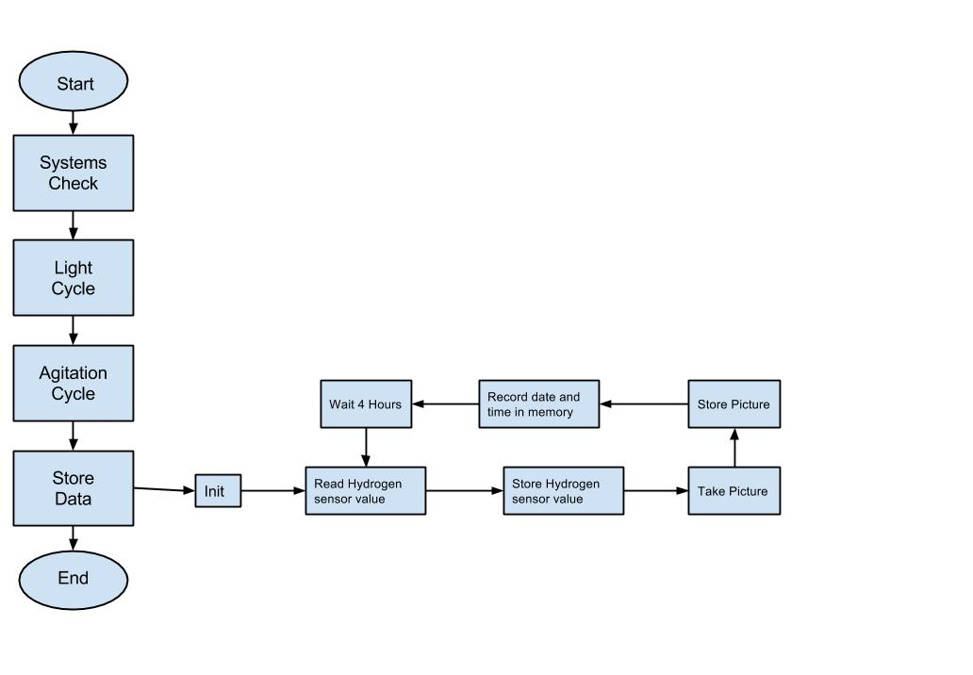
Story Board: Store Values

Slide 23
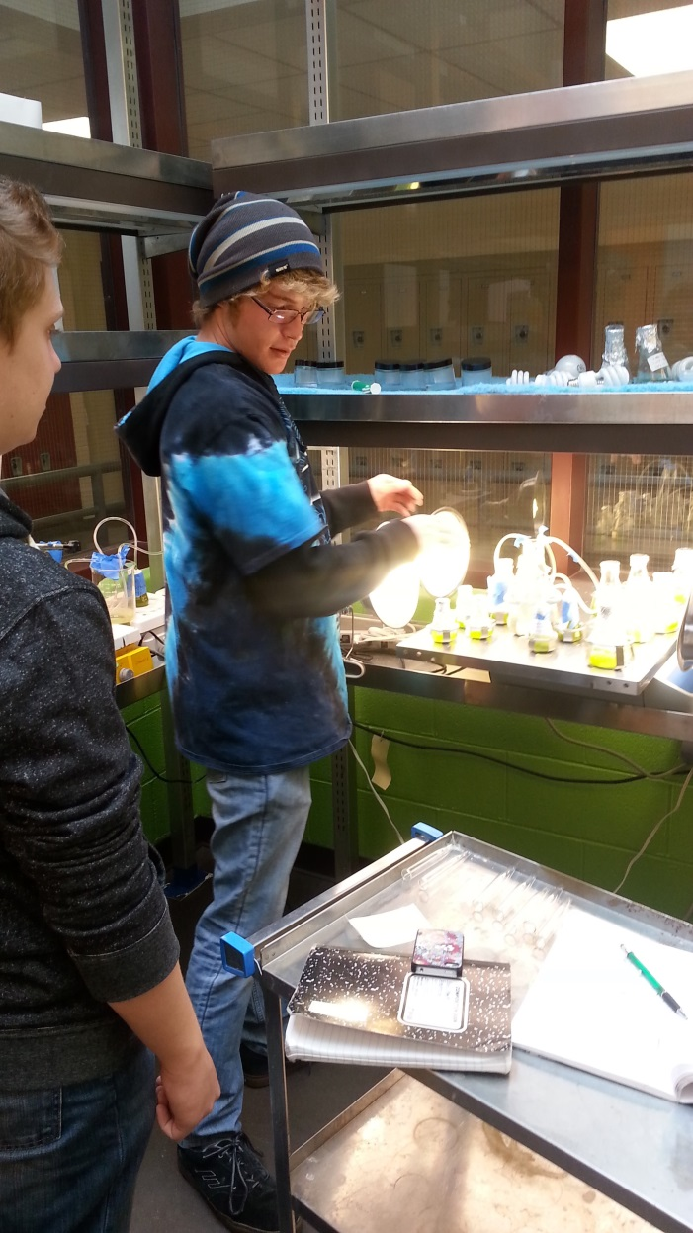
Chlorella vulgaris: Lipid Production Paul Stanfel

Slide 24
Research
Various groups have shown that Chlorella vulgaris responds to nitrate stress by storing lipids within the cell
By limiting the concentration of nitrate within the bioreactor, we can adjust the onset of lipid production
These fats can be harvested and processed into biofuels

Slide 25
Our Design
4 chambered bioreactor with varying density of cells or nitrate to study effect of cell/nitrate density on lipid production
Lights on NESI board shine through each bioreactor to photosensors at the bottom
As lipids are produced, more light will be absorbed by the algae
Added absorbance registered by photosensors
Bioreactor designed to keep solution contained with a head-space ratio of 4:1

Slide 26
Our Experiments
Testing bioreactors with varying concentrations of nitrate to determine concentration to produce maximum nitrates at the launch + 3 week time frame.
Absorbence tested in spectrometer to determine differences in concentrations of lipids in solution

Slide 27
Results
Inconclusive at this time
Algae does not seem to have stored significant lipid concentrations at this time
As lipids accumulate, solution turns a mustard yellow – we plan to observe this using our onboard camera
We have yet to observe a significant change in our solutions

Slide 28
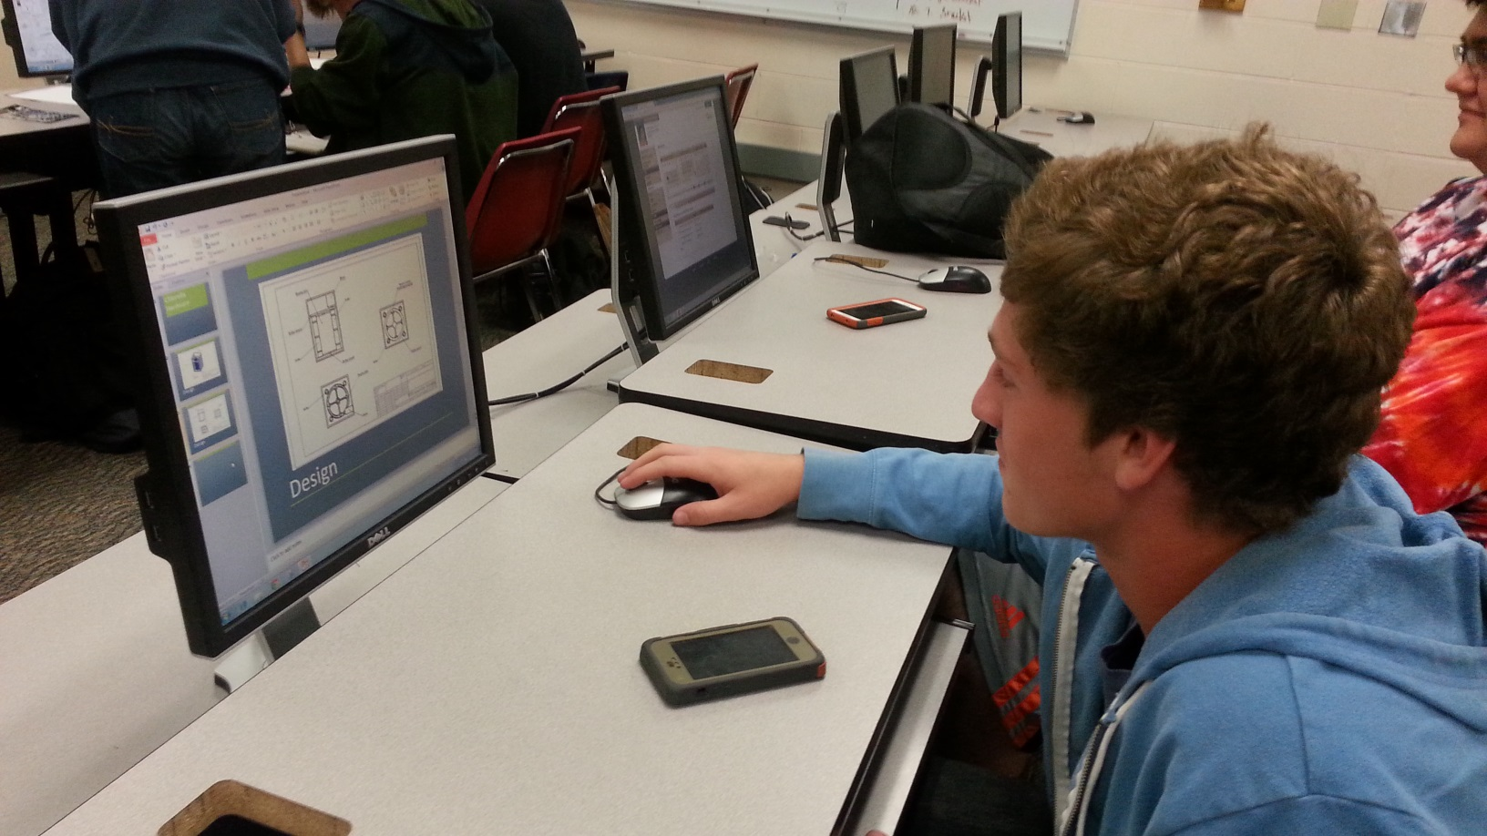
Chlorella Hardware Trevor Schrepel

Slide 29
Materials
Gas Permeable Membrane
Bioreactor/Box/Rollers all printed in ABS Plastic
O-rings to spin reactor
Sealed flanged bearings
Gasket to seal bioreactor
Motor
Photosensors with white LEDs
Clear Lid-Polycarbonate
Fasteners

Slide 30
Design Overview

Slide 31
General Design

Slide 32
Bioreactor Design

Slide 33
End Support Design

Slide 34
Bioreactor Support Design

Slide 35
Interior Box Design

Slide 36
Motor Mount Roller Design

Slide 37
General Roller Design

Slide 38
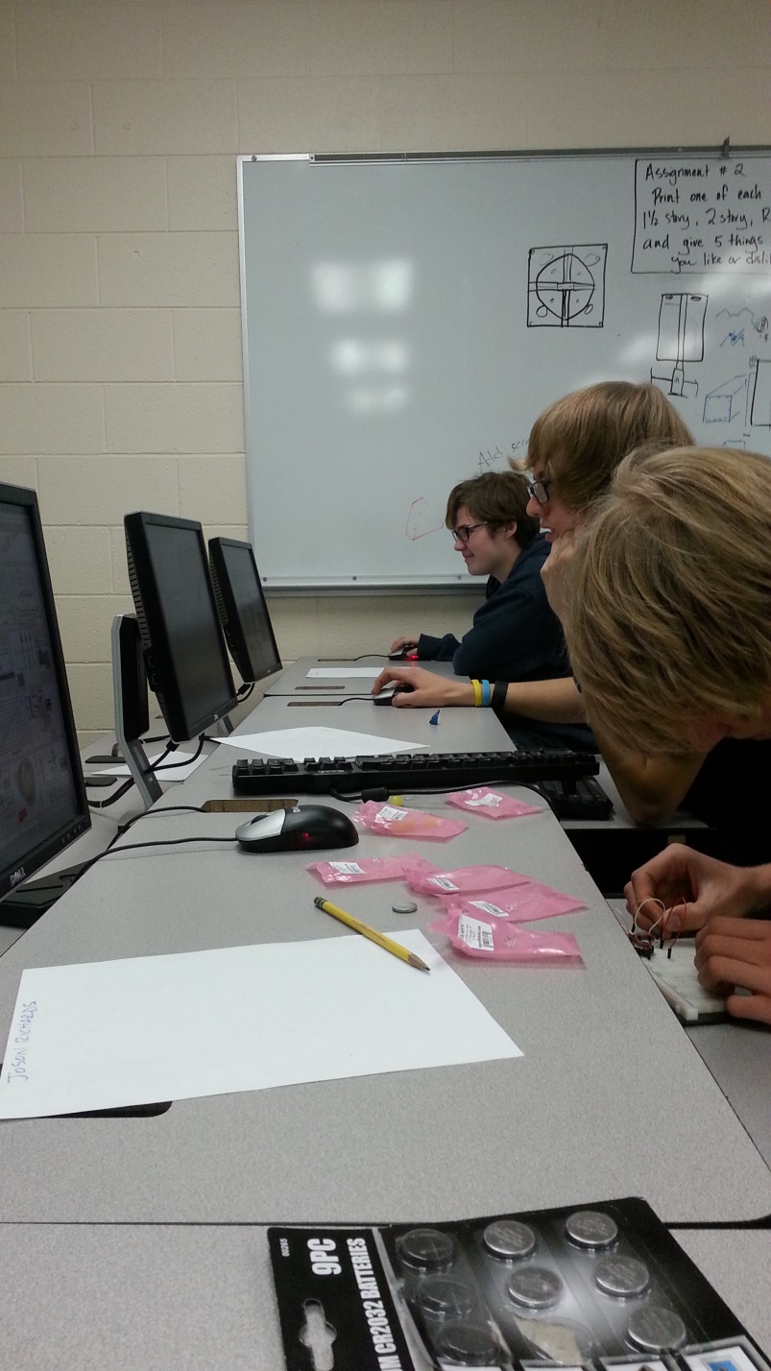
Chlorella Software Group Cory Baxes Tim Stroup

Slide 39
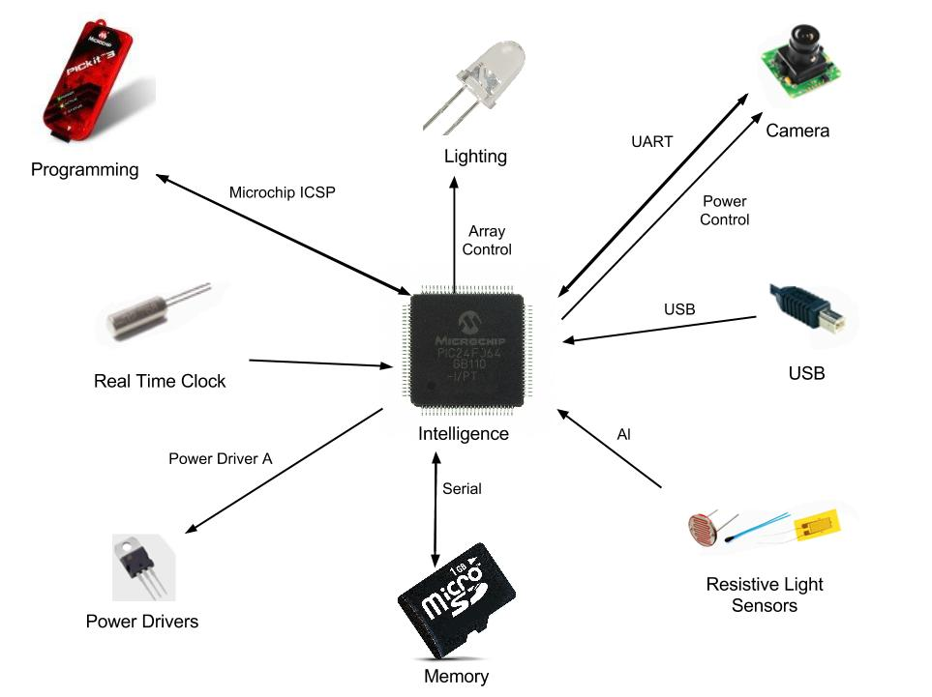
Conceptual Block Diagram

Slide 40
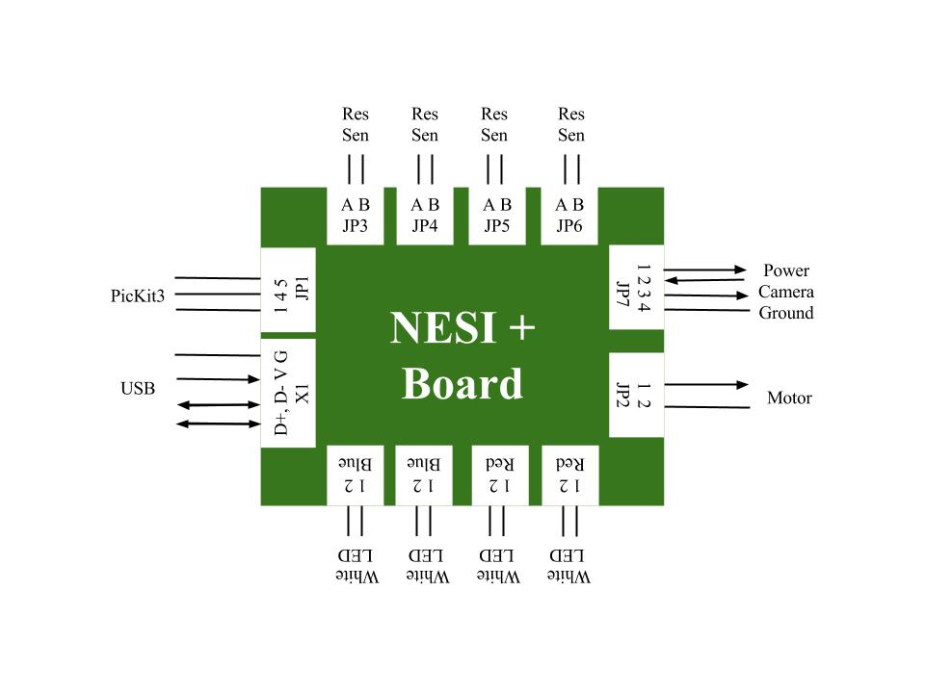
Functional Block Diagram

Slide 41
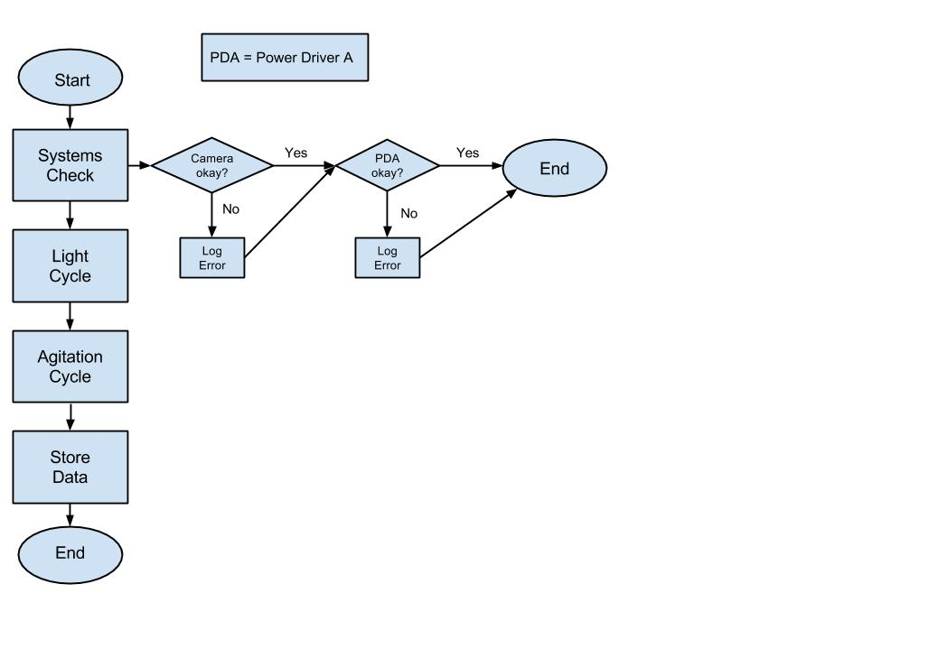
Story Board: System Check

Slide 42
Story Board: Light Cycle

Slide 43
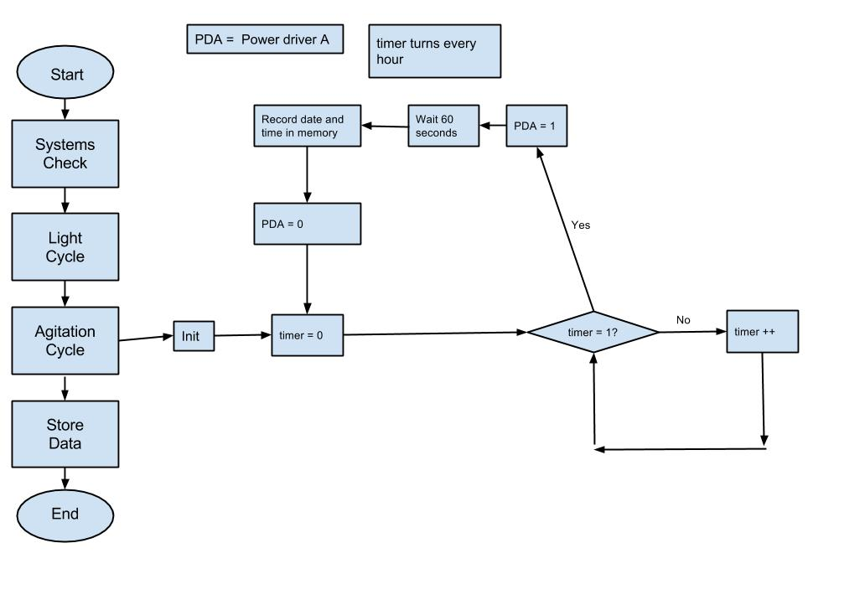
Story Board: Agitation Cycle

Slide 44
Story Board: Store Values

Slide 45
Outreach and more…
We have just begun a school wide contest to design our mission shirt and mission patch.
We are also working with NREL to establish Bioreactors in our feeder schools to have them grow algae with us
We plan to visit all of our feeder schools during the course of this year to present our experiment to their science and STEM classes

Slide 46
Questions?

