Slide 1
Chlammy Hardware
Alec, Austin, Alex, Tyler

Slide 2
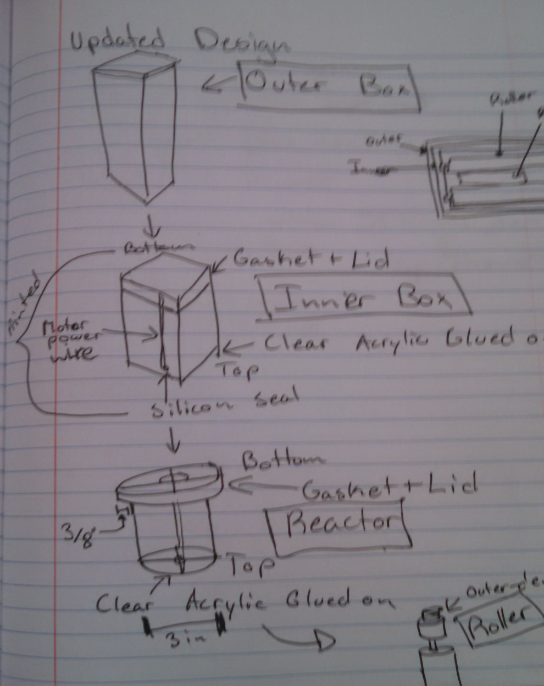
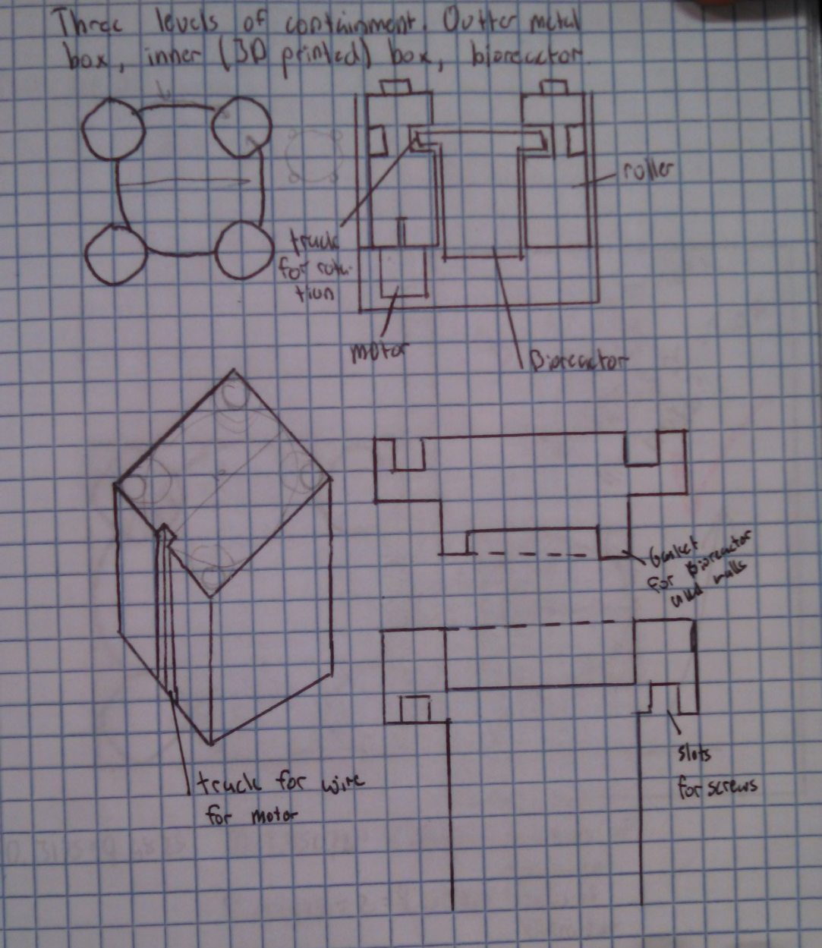
Design

Slide 3
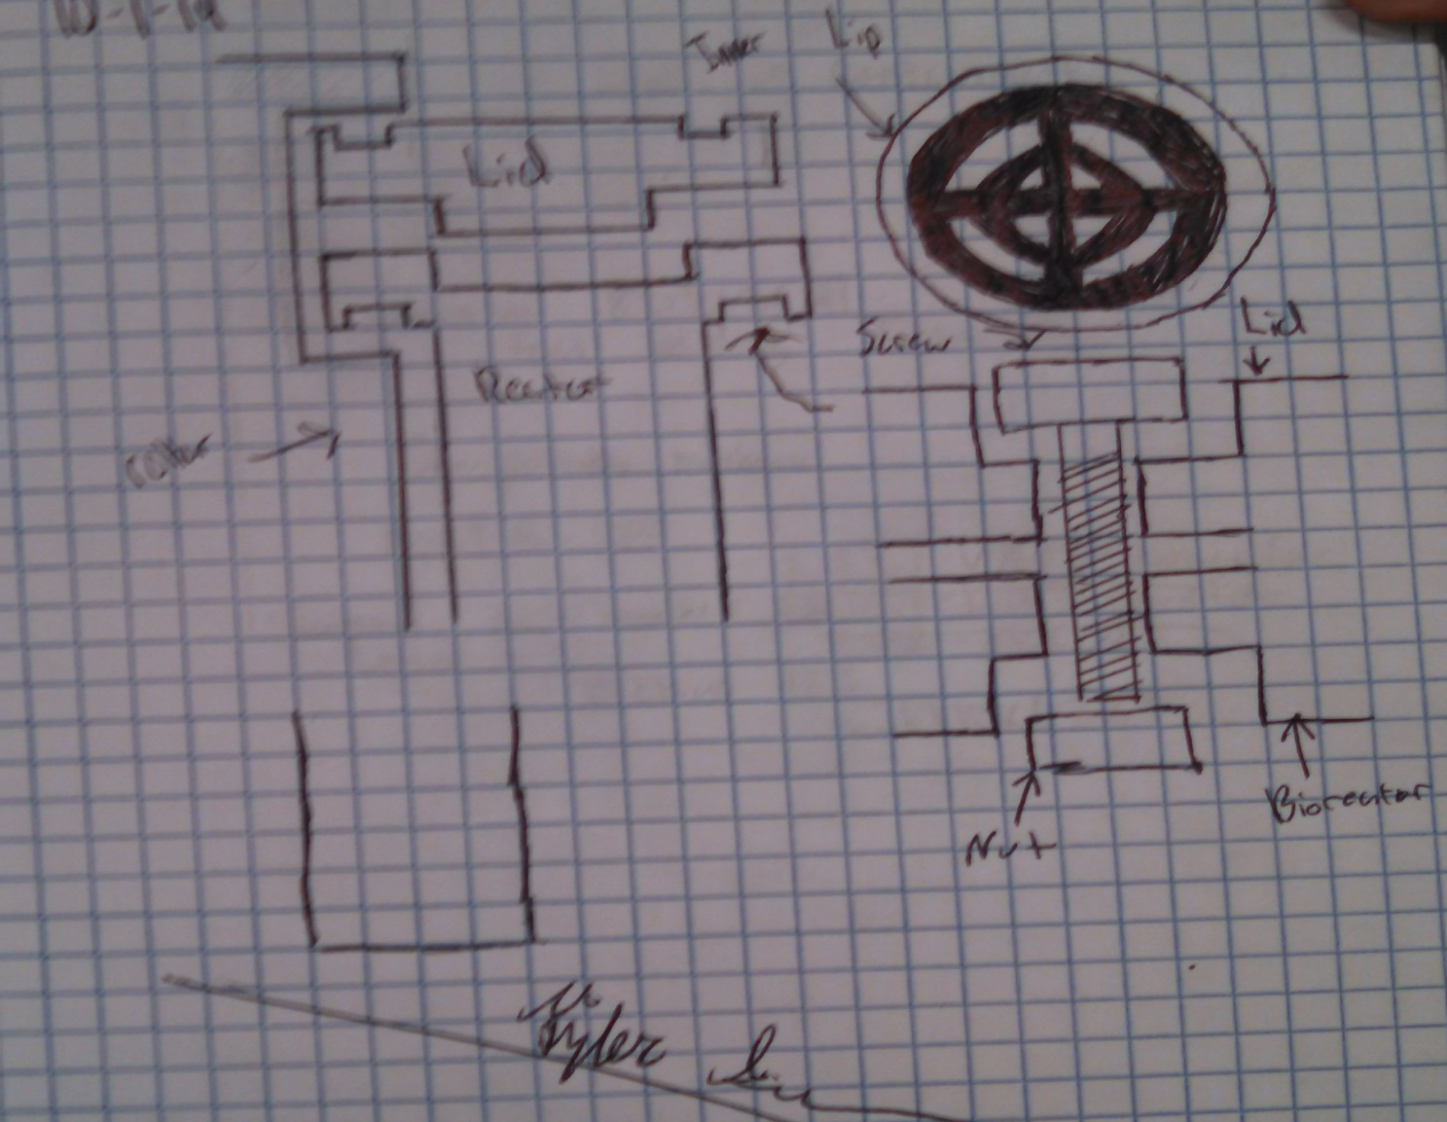
Design

Slide 4
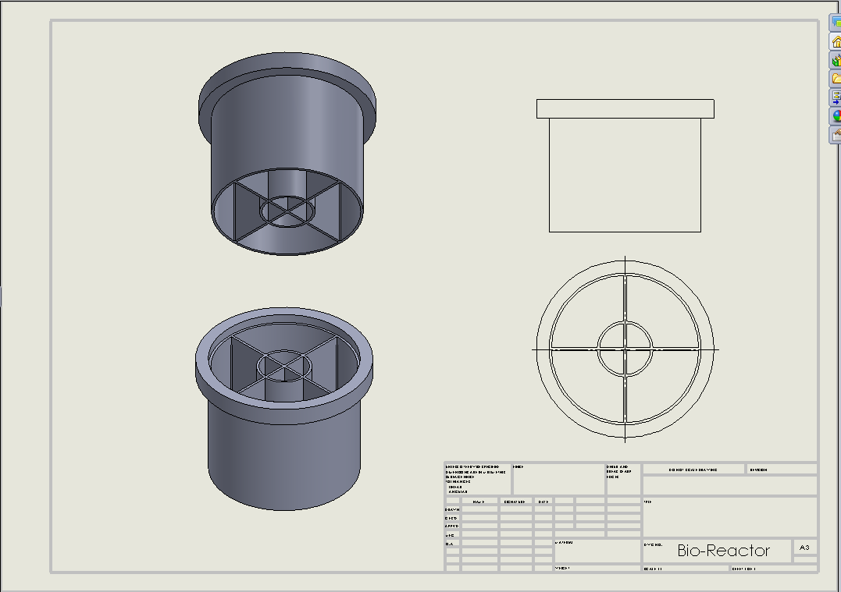
Bioreactor

Slide 5
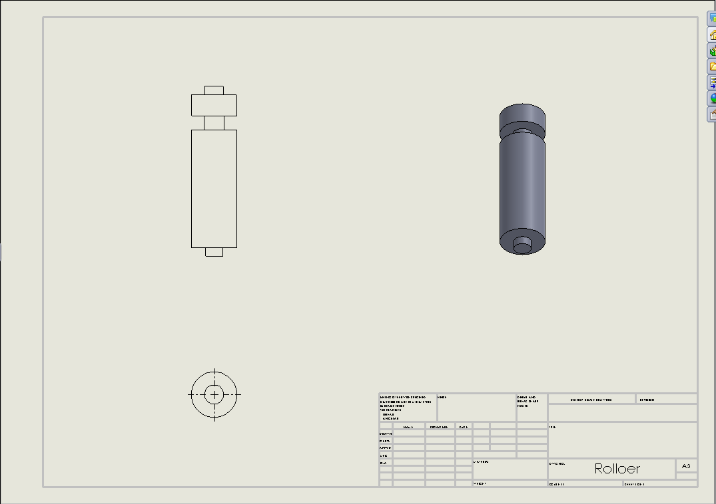
Rollers

Slide 6
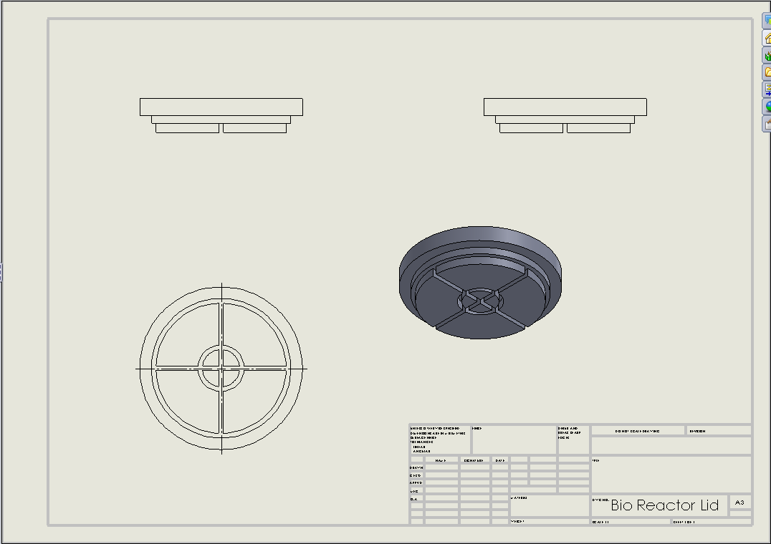
Lid

Slide 7
Materials List
Hydrogen Sensor - SEN-10916 ROHS from Sparkfun
90 RPM Micro Gear motor - ROB-12285 from Sparkfun
90 RPM Micro Gear motor enclosure - ROB-12105 from Sparkfun
2 X LED SMD (Strip of 25) - PRT-12621 from Sparkfun
3D printer plastic for the bio-reactor and rollers – PN 340-20000, P400 ABS model cartridge
PlexiGlass for top of bio-reactor
Gore-Tex membrane
NESI Board
Camera

