Slide 1
Chlorella Hardware Group #1
Trevor Schrepel, Jacob Larsen, Kyle Henry

Slide 2
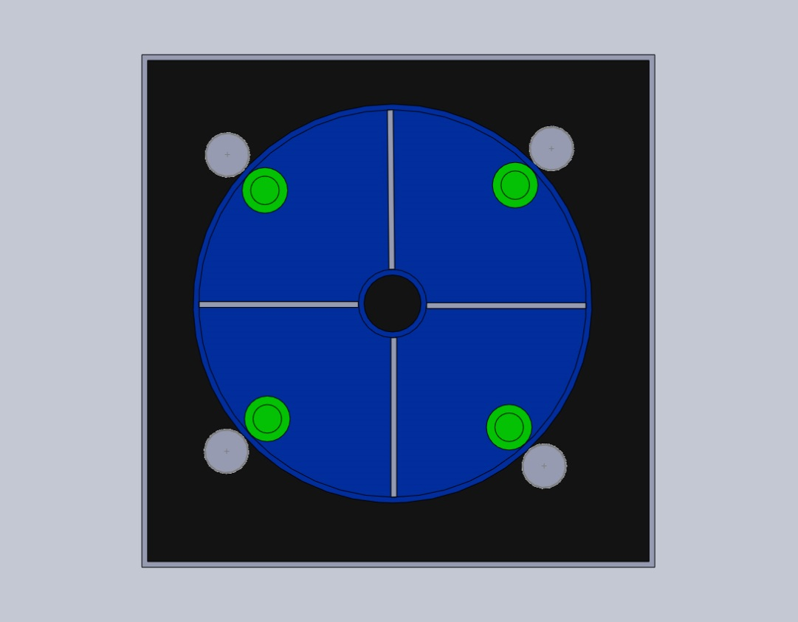
Design (TOP)
Dimensions:
Frame
9x9x13cm
Bioreactor
4cm radius
8cm height
Center
.5cm radius
Walls
1mm thick
Rollers
.4cm radius
9cm height
Mount
9x8.8x0.2cm
Lid attachment
.35cm radius
7.8cm height

Slide 3
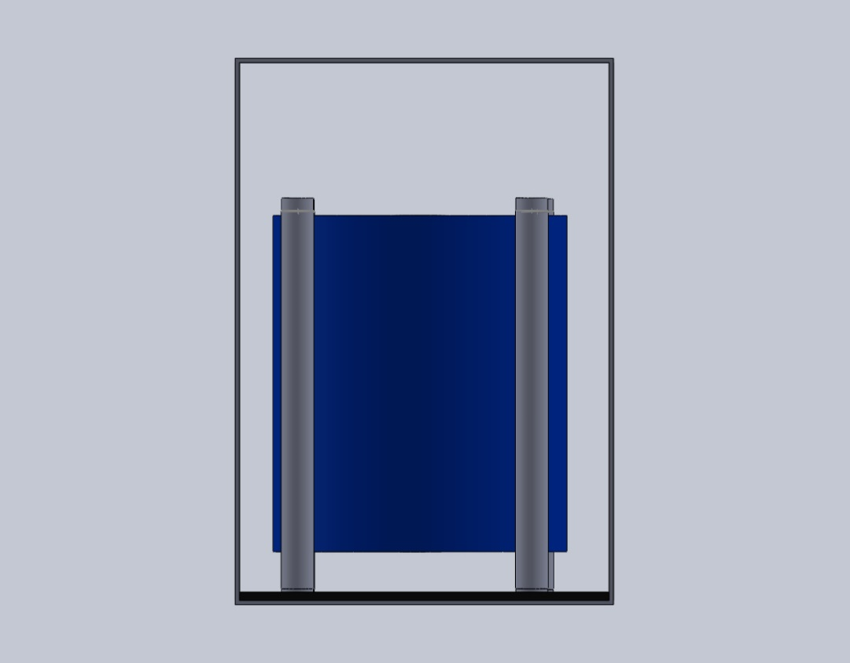
Design (SIDE)
Dimensions:
Frame
9x9x13cm
Bioreactor
4cm radius
8cm height
Center
.5cm radius
Walls
1mm thick
Rollers
.4cm radius
9cm height
Mount
9x8.8x0.2cm
Lid attachment
.35cm radius
7.8cm height

Slide 4
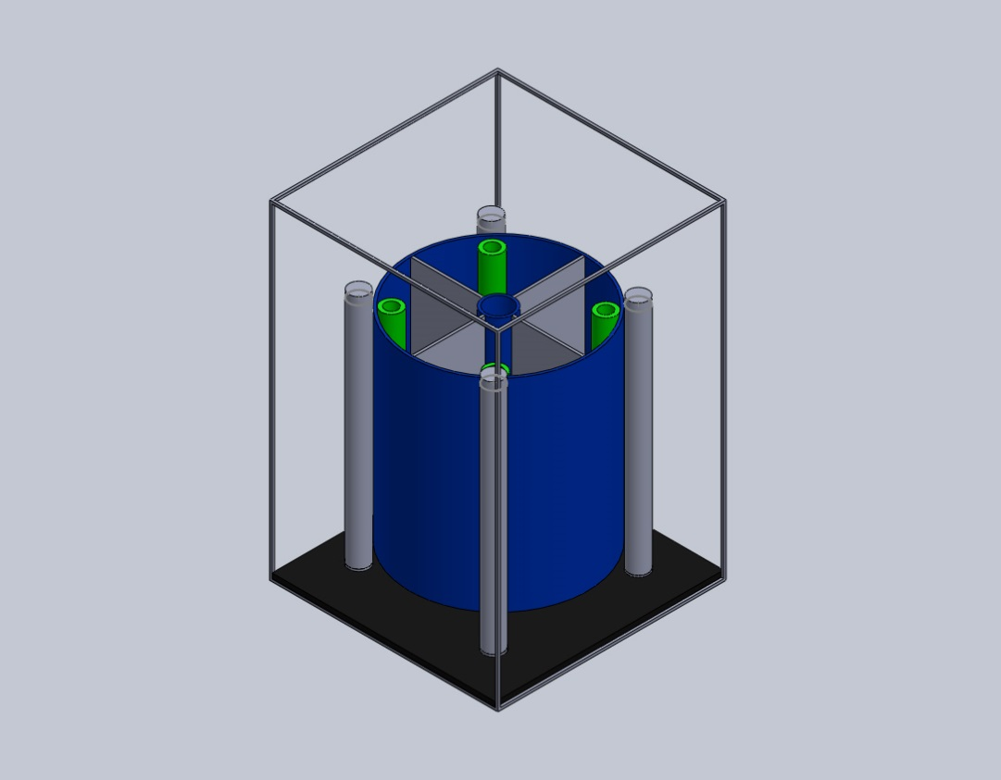
Design (ANGLED)
Dimensions:
Frame
9x9x13cm
Bioreactor
4cm radius
8cm height
Center
.5cm radius
Walls
1mm thick
Rollers
.4cm radius
9cm height
Mount
9x8.8x0.2cm
Lid attachment
.35cm radius
7.8cm height

Slide 5
Materials
ABS Plastic for Bio-reactor
Micro gear Motor from SparkFun
Led Lights
Photo sensors
Clear Plastic or Glass for lid
Plexiglass
Polycarbonate
Highly Transparent to visible light, with better light transmission than many kinds of glass.
Cleaning Methods
Amyl Alcohol
Bolts, nuts, and/or screws

